Slide 1


AI-Powered Fake News Classifier Using Hybrid Transformer–LSTM Models
Dhruv Gupta S24CSEU0819 Gyanendra Prakash S24CSEU0771 Goutam Mittal S24CSEU0785

Slide 2

Problem Statement
The rapid spread of fake news across digital platforms has become a major threat to society, influencing public opinion, increasing misinformation, and causing social and political instability. Traditional text-classification techniques struggle to accurately detect fake news due to:
1. Highly contextual language
2. Manipulative writing patterns
3. Large and diverse datasets
4. Need for deep semantic understanding
There is a need for an automated, accurate, and scalable fake news detection system.

Slide 3
PROPOSED SOLUTION
To address the challenge of detecting misleading and fabricated news, we propose an AI-driven hybrid fake news detection system that leverages both traditional machine learning and modern deep learning techniques. Our solution integrates advanced Transformer-based language models such as RoBERTa and DistilBERT with LSTM/Bi-LSTM networks to capture both deep contextual meaning and sequential text patterns. The system begins by merging and cleaning large-scale datasets, followed by robust preprocessing including lemmatization, stopword removal, and text normalization. We build TF-IDF based machine learning baselines for comparison and develop high-performance hybrid models that combine Transformer embeddings with recurrent layers for classification. The final pipeline identifies fake news with exceptional accuracy and offers a deployable model capable of real-time prediction, making it a scalable and reliable solution to combat misinformation.

Slide 4




GOALS AND OBJECTIVES
Develop an accurate and scalable AI model capable of distinguishing fake news from real news using advanced Natural Language Processing techniques..
Integrate and preprocess large, diverse datasets to create a clean, balanced, and high-quality training corpus suitable for both traditional ML and deep learning models.
Design, train, and evaluate hybrid Transformer–LSTM models (RoBERTa/DistilBERT + LSTM/Bi-LSTM) to achieve superior performance compared to classical machine learning baselines.
Empowering Users
Diverse Categories
Incorporating AI

Slide 5
Technologies Used
Python for data processing, modeling, and pipeline development.
Pandas, NumPy, NLTK for data cleaning, preprocessing, and text normalization.
Scikit-learn & XGBoost for traditional machine learning model training and evaluation.
TensorFlow & Keras for building and training hybrid LSTM/Bi-LSTM deep learning architectures.
HuggingFace Transformers (RoBERTa, DistilBERT) for state-of-the-tart ext embeddings and NLP modeling.

Slide 6
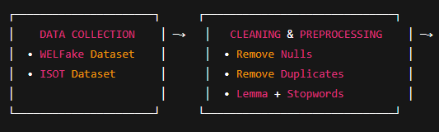
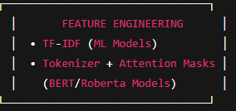
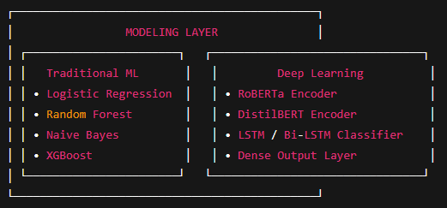
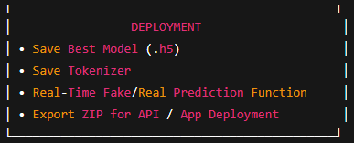
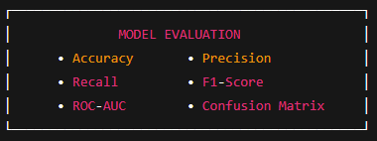
Workflow

Slide 7
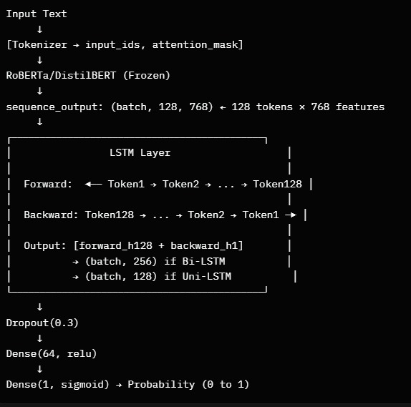
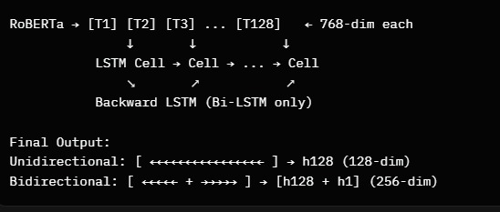
Architecture(DL)

Slide 8

Multi-Dataset Training: Merged datasets for robust accuracy.
Advanced Preprocessing:
Clean, lemmatized, normalized news text.
Hybrid Architecture:
Transformer + LSTM for deeper understanding.
ML Baseline Models :
LogReg, RF, XGBoost for comparison.
KEY FEATURES
Deployment Ready : Model + tokenizer for real-time use.
High Performance Metrics : AUC up to 0.99 achieved.

Slide 9
Future Prospects
The system can be further enhanced by integrating multilingual fake news detection, allowing it to operate across global news sources. Future versions can incorporate real-time web scraping and social media monitoring to automatically flag emerging misinformation. The model can also be fine-tuned with domain-specific datasets such as healthcare, politics, or finance for improved contextual accuracy. Additionally, integrating explainable AI (XAI) will help users understand why a piece of news is classified as real or fake, improving trust and transparency. Finally, deploying the system as a scalable API or browser extension can make fake news detection accessible to journalists, students, and the general public.

Slide 10
Thank You!

